Slide 1
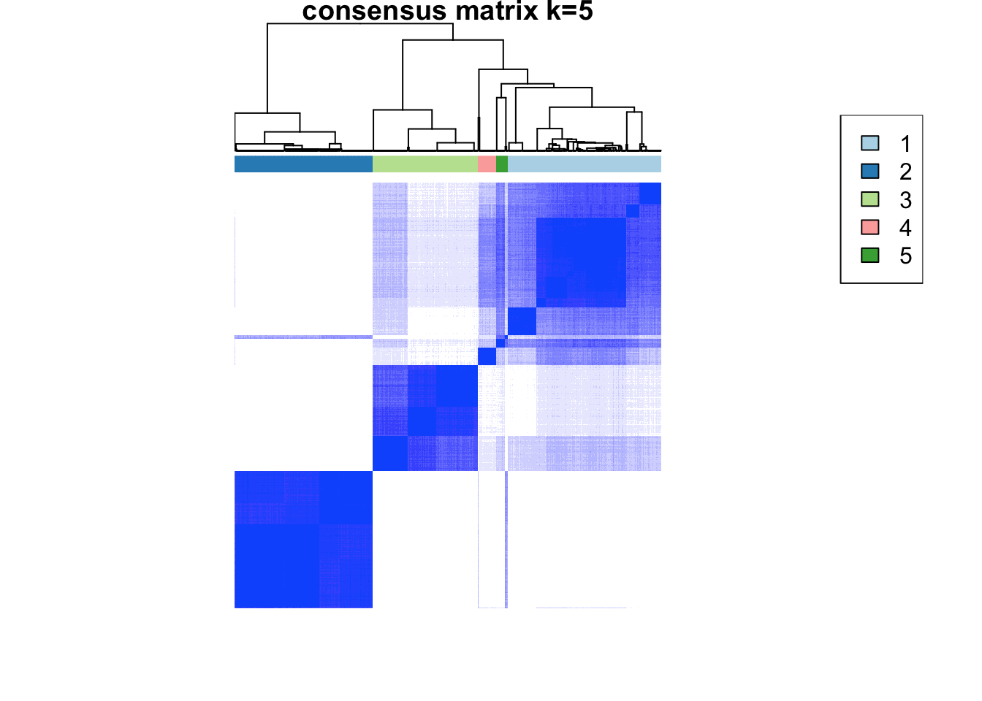
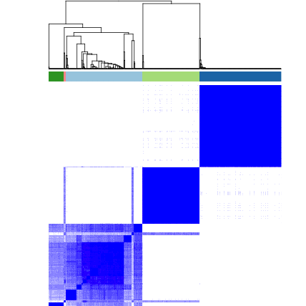
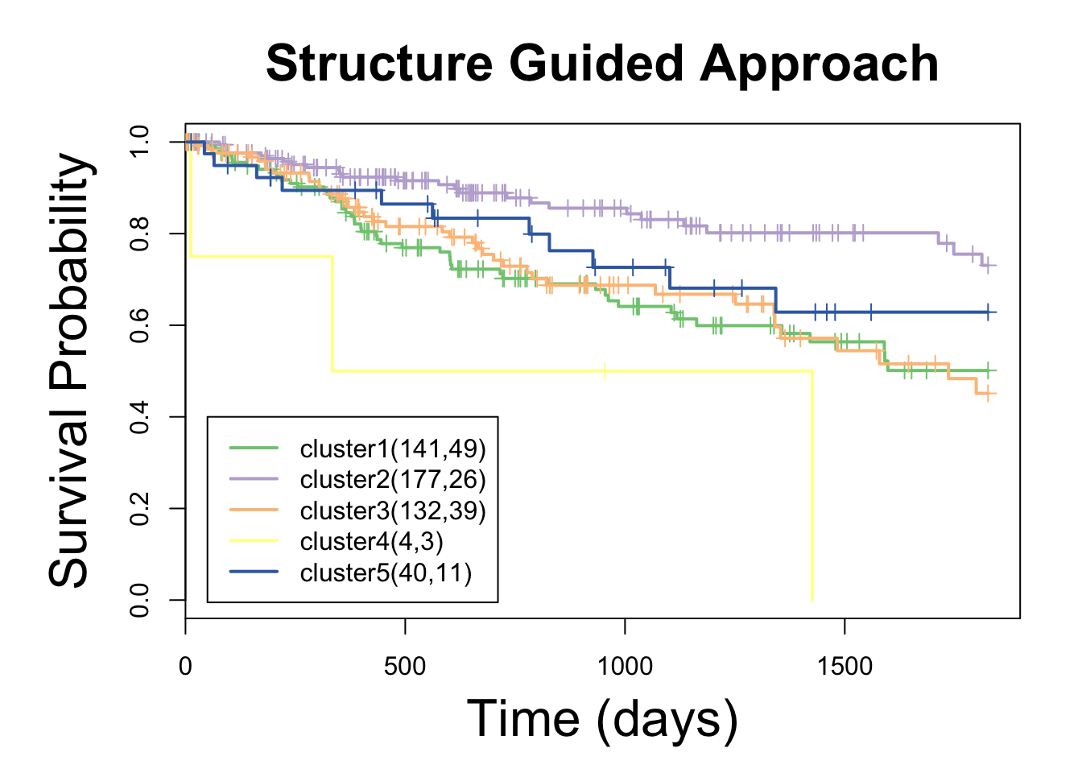
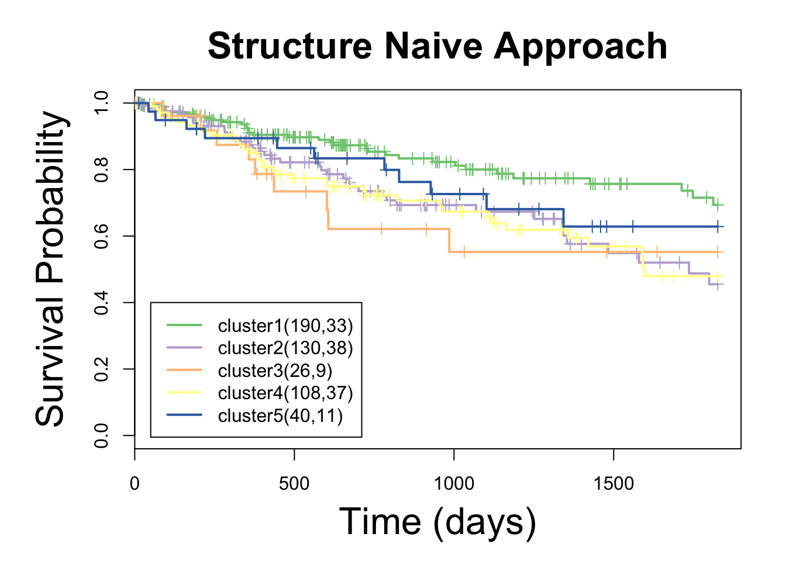
Translational Implications (494 patients)
Remove Specific Edges
Remove All Edges
P < 0.0005
P < 0.02
p = 0.000224
Notes:
Reduced number of patients for survival curves (494)
Consensus clustering – K=5 based on the elbow methods
GBM, Thyroid, Prostate patients and patients older than 75 years filtered
500 patients (differential structural mutations + RNAseq data in TCGA)

Slide 2
Large-scale Analysis of Cancer Mutations using a Structurally Resolved PPI Network
~ 2 million somatic mutations
Amino acid residues mapped to protien interactions using co-crystal structures in the PDB
Novel representation as a bipartite protein-residue interaction network

Slide 3
Example 2: Network-based Stratification

Slide 4

Network-based Patient Stratification (NBS)
Molecular Profiles
Patients
Mutations are too sparse for effectively clustering samples
Hofree et al, Nature Methods 2013
Notes:
Project that I came into halfway through

Slide 5
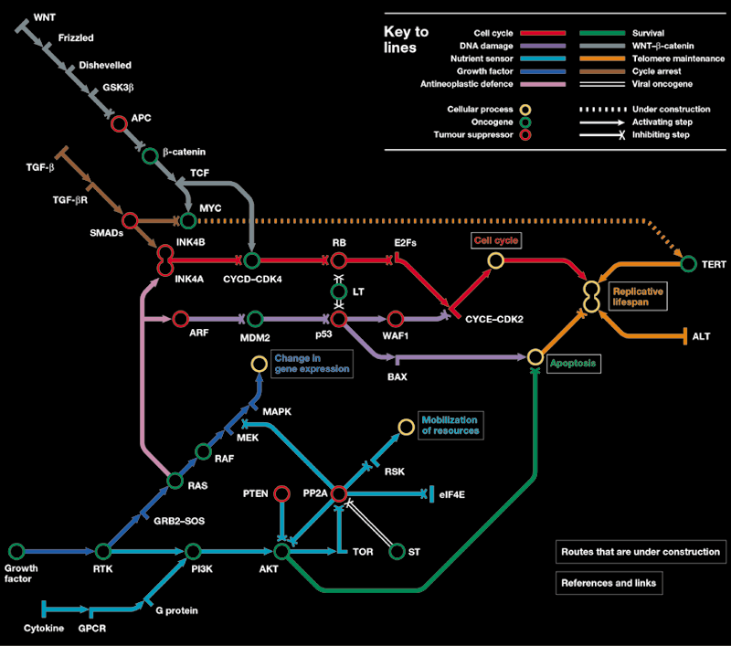
A subway map of cancer pathways
Hahn and Weinberg. Nat Rev Cancer 2002

Slide 6
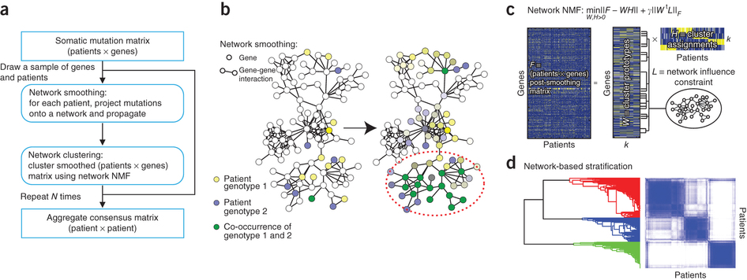
Network-Based Stratification (NBS)
Hofree et al, Nature Methods 2013
Notes:
NMF with a penalty designed – find a solution that respects the network topology

Slide 7
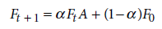
An intuition for network smoothing
Genotype A:
[…,0,0,1,0,0,1,0,0,0,0,0,0,0,0,0,1,0,0…]
Genotype B:
[…,0,0,1,0,0,0,0,0,0,1,0,0,0,0,0,0,0,0…]
Genotype A: […,0,0.1,1,0.2,0.1,1,0,0,0,0.2,0,0,0,0.1,0,1,0,0…]
Genotype B:
[…,0,0,1,0.1,0.1,0,0,0,0.2,1,0,0,0,0,0,0,0.2,0…]
Genotype A: […,0,0.2,1,0.3,0.2,1,0,0,0,0.2,0,0,0,0.3,0,1,0.1,0…]
Genotype B:
[…,0,0.1,1,0.3,0.4,0,0,0,0.4,1,0,0,0,0,0.1,0.1,0.5,0…]
Genotype A: […,0,0.3,1,0.4,0.4,1,0.1,0,0,0.3,0,0,0,0.4,0,1,0.2,0…]
Genotype B: […,0,0.3,1,0.2,0.4,0.1,0,0,0.4,1,0,0,0,0,0.2,0.2,0.5,0…]
Genotype A: […,0,0.3,1,0.4,0.4,1,0.2,0,0,0.3,0,0,0,0.4,0,1,0.2,0…]
Genotype B: […,0,0.3,1,0.2,0.4,0.2,0,0,0.4,1,0,0,0,0,0.2,0.4,0.5,0…]

Slide 8
An intuition for network smoothing
Genotype A: […,0,0.3,1,0.4,0.4,1,0.2,0,0,0.3,0,0,0,0.4,0,1,0.2,0…]
Genotype B: […,0,0.3,1,0.2,0.4,0.2,0,0,0.4,1,0,0,0,0,0.2,0.4,0.5,0…]

Slide 9
Network-Based Stratification (NBS)
Molecular Profiles
Patients
Pathway Activities
Hofree et al, Nature Methods 2013
Notes:
Molecular profiling

Slide 10
Network-Based Stratification (NBS)
Molecular Profiles
Patients
Pathway Activities
Prognoses
Hofree et al, Nature Methods 2013
Notes:
Molecular profiling

Slide 11
Network-Based Stratification (NBS)
Molecular Profiles
Patients
Pathway Activities
Prognoses
Therapeutic Responses
Drug A
Drug B
Drug C
Hofree et al, Nature Methods 2013
Notes:
Molecular profiling

Slide 13
Example 3: Network Analysis of Gene Expression Data

Slide 14
Networks And Gene Expression
Map gene expression onto nodes in the network
Identify regions of the network enriched for differentially expressed genes

Slide 15
Need a scoring system for expression activity
Each node in the network assigned a differential expression fold-change (usually log scale) and significance (p-value)
Can generate an aggregate z-score for a set of nodes
Expression fold-changes can be misleading

Slide 16
Analysis of gene expression with pathway scores
Zien, Kuffner, Zimmer, Lengauer (2000) originally proposed a method for scoring gene expression activity of a given metabolic reaction pathway P:
S(G) is a p-value of differential expression or an average correlation coefficient vs. genes in P
More recently, statistics have been modified to use z-scores

Slide 17
Searching for “active” pathways in a large network
Score subnetworks according to their overall amount of activity
Finding the highest scoring subnetworks is NP hard, so we use heuristic search algs. to identify a collection of high-scoring subnetworks (local optima)
Simulated annealing and/or greedy search starting from an initial subnetwork “seed”
During the search we must also worry about issues such as local topology and whether a subnetwork’s score is higher than would be expected at random
Notes:
So now that we have a scoring system, we can turn to the problem of finding the high-scoring pathways themselves.

Slide 18
Excercises

